Slide 1

Building Networking Platforms for UCW Students
Aditya Prashant Arte (2305505)
Amandeep Singh (2231193)
Maduka Aravindi (2316990)
Obioma Joseph Nwagwu (2313367)
Rajani Mishra (2303650)
Busi 653: Cloud Computing Technologies (HBD-WINTER25-02)
Professor: Sarah Gholibeigian
Due: 23rd March,2023

Slide 2
Feasibility and Implementation Overview
Feasibility Analysis:
AWS offers scalability, cost-efficiency, and global accessibility.
Services like EC2, RDS, S3, and Lambda are ideal for building dynamic platforms like social networks.
Key AWS Features Implemented:
EC2 for compute, RDS for relational data, DynamoDB for NoSQL, and S3 for multimedia storage.
Elastic Beanstalk simplified app deployment.
Implementation Challenges:
IAM permission issues, S3 access denials, and security group misconfigurations.
Resolved by adjusting policies, roles, and port settings.

Slide 3
Key Platform Requirements
USER INTERFACE
A clean, intuitive interface with profile creation, secure login, dashboard customization, and seamless interaction. Multilingual support will cater to UCW’s diverse student body, promoting inclusivity and accessibility.
DATABASE MANAGEMENT
A well-structured database using AWS DynamoDB and RDS to efficiently store and retrieve user profiles, posts, and multimedia content. Reduces downtime and optimizes data organization for a user-friendly experience.
These features enhance user engagement and satisfaction, foster adoption, minimize training costs, facilitate scalability, and ensure accurate data access.

Slide 4

Networking, Connectivity, Security, and Compliance
Networking and Connectivity
Security and Compliance
A secure VPC with AWS Elastic Load Balancer (ELB) ensures reliable traffic management, preventing overload during peak activity like exams and events.
Multi-Factor Authentication (MFA) and encryption protocols protect user data, complying with PIPEDA and other provincial standards, positioning the platform as trustworthy
Guarantees smooth performance, fosters trust in platform reliability, builds user trust, and mitigates risks of data breaches.

Slide 5

Data Management Considerations
TEXT POSTS
Facilitate discussions and feedback among users, creating a community-focused environment.
IMAGES
Enrich user interactions through visual content, capturing memorable times and events.
VIDEOS
Deliver multimedia content for educational, promotional, and recreational purposes
METADATA LOGS
Monitor system usage and user interactions for optimized platform performance and continuous data-based improvements.

Slide 6
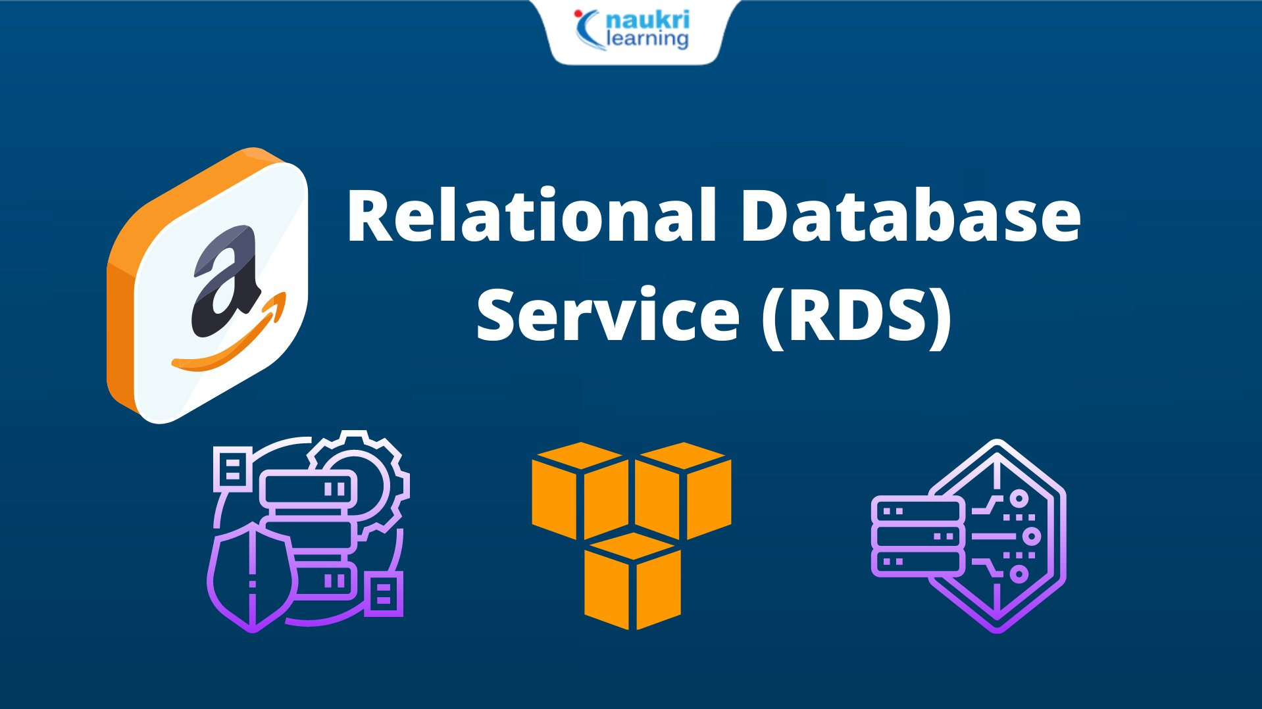

Storage and Database Services Selection
Amazon RDS (Relational Database Service)
Manages structured data (student profiles, posts, announcements)
Benefits: Automated backups, multi-AZ deployment, zero downtime
Amazon S3 (Simple Storage Service)
Purpose: Stores media files (profile pictures, course notes, recordings)
Cost Optimization: Moves old files to S3 Glacier for low-cost storage
Security: Automatic backups prevent data loss

Slide 7

Amazon DynamoDB
Purpose: NoSQL database for real-time messaging & notifications
Use Case: Supports discussion threads & student engagement
Benefit: Scales automatically to handle high traffic

Slide 8
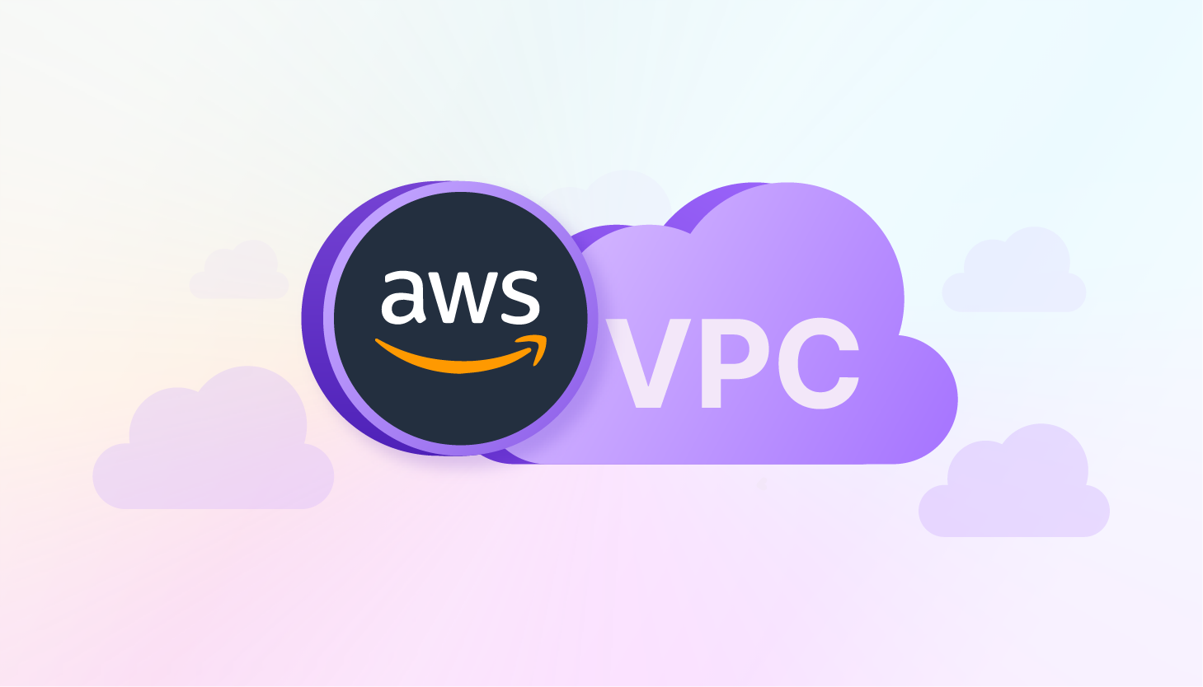


Networking and Security Services Selection
Amazon VPC (Virtual Private Cloud)
Purpose: Ensures secure networking and data segregation
Use Case: Keeps student/faculty data private, while allowing public web access
AWS Route 53
Purpose: Domain name resolution & performance optimization
Use Case: Directs traffic based on location and ensures platform availability
AWS Shield
Purpose: Protects against DDoS attacks
Use Case: Detects & filters suspicious traffic to keep platform secure

Slide 9

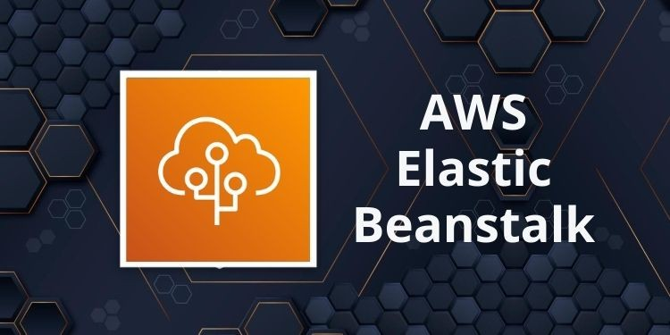
Compute and Hosting Services Selection
Amazon EC2 (Elastic Compute Cloud)
Provides computing power to host the platform’s backend
Benefits: Secure, scalable (auto-scaling), cost-effective
Hosts web application to manage student requests.
AWS Elastic Beanstalk
Purpose: Automates deployment and scaling of web apps
Supports multiple programming languages
Benefit: Handles peak traffic during exams/university events

Slide 10
Cost Estimation
Service | Estimated Monthly Cost (USD) | References
Amazon EC2 (t3. medium, web hosting) | $40 - $80 | (CAST AI, 2024)
AWS Elastic Beanstalk | Included in EC2 pricing | (CAST AI, 2024)
Amazon S3 (100GB storage for images/videos) | $2 - $10 | (CAST AI, 2024)
Amazon RDS (db.t3. micro, 20GB storage) | $15 - $50 | (CAST AI, 2024)
Amazon DynamoDB (100K reads/writes per month) | $10 - $30 | (CAST AI, 2024)
Amazon VPC & Route 53 | $5 - $15 | (CAST AI, 2024)
AWS CloudFront (1TB bandwidth) | $50 - $100 | (CAST AI, 2024)
AWS IAM, WAF, Shield | $10 - $50 | (CAST AI, 2024)
Total Estimated Monthly Cost | $150 - $350

Slide 11
AWS Core Cloud Service Implementation — UCW Social Network Platform
Objective: Deploy a scalable cloud infrastructure using AWS to support a student social networking platform.
Key Services Implemented:
VPC: Custom VPC with CIDR 10.0.0.0/16, including public/private subnets and internet gateway.
EC2: Amazon Linux 2023 instance in a public subnet.
RDS: MySQL 8.0 database in private subnet, no public access.
Elastic Beanstalk: Configured PHP environment and linked it to RDS.
SSH Access: Used key pair to securely access EC2.
Tech Stack: Nginx, PHP, MySQL (RDS)

Slide 12
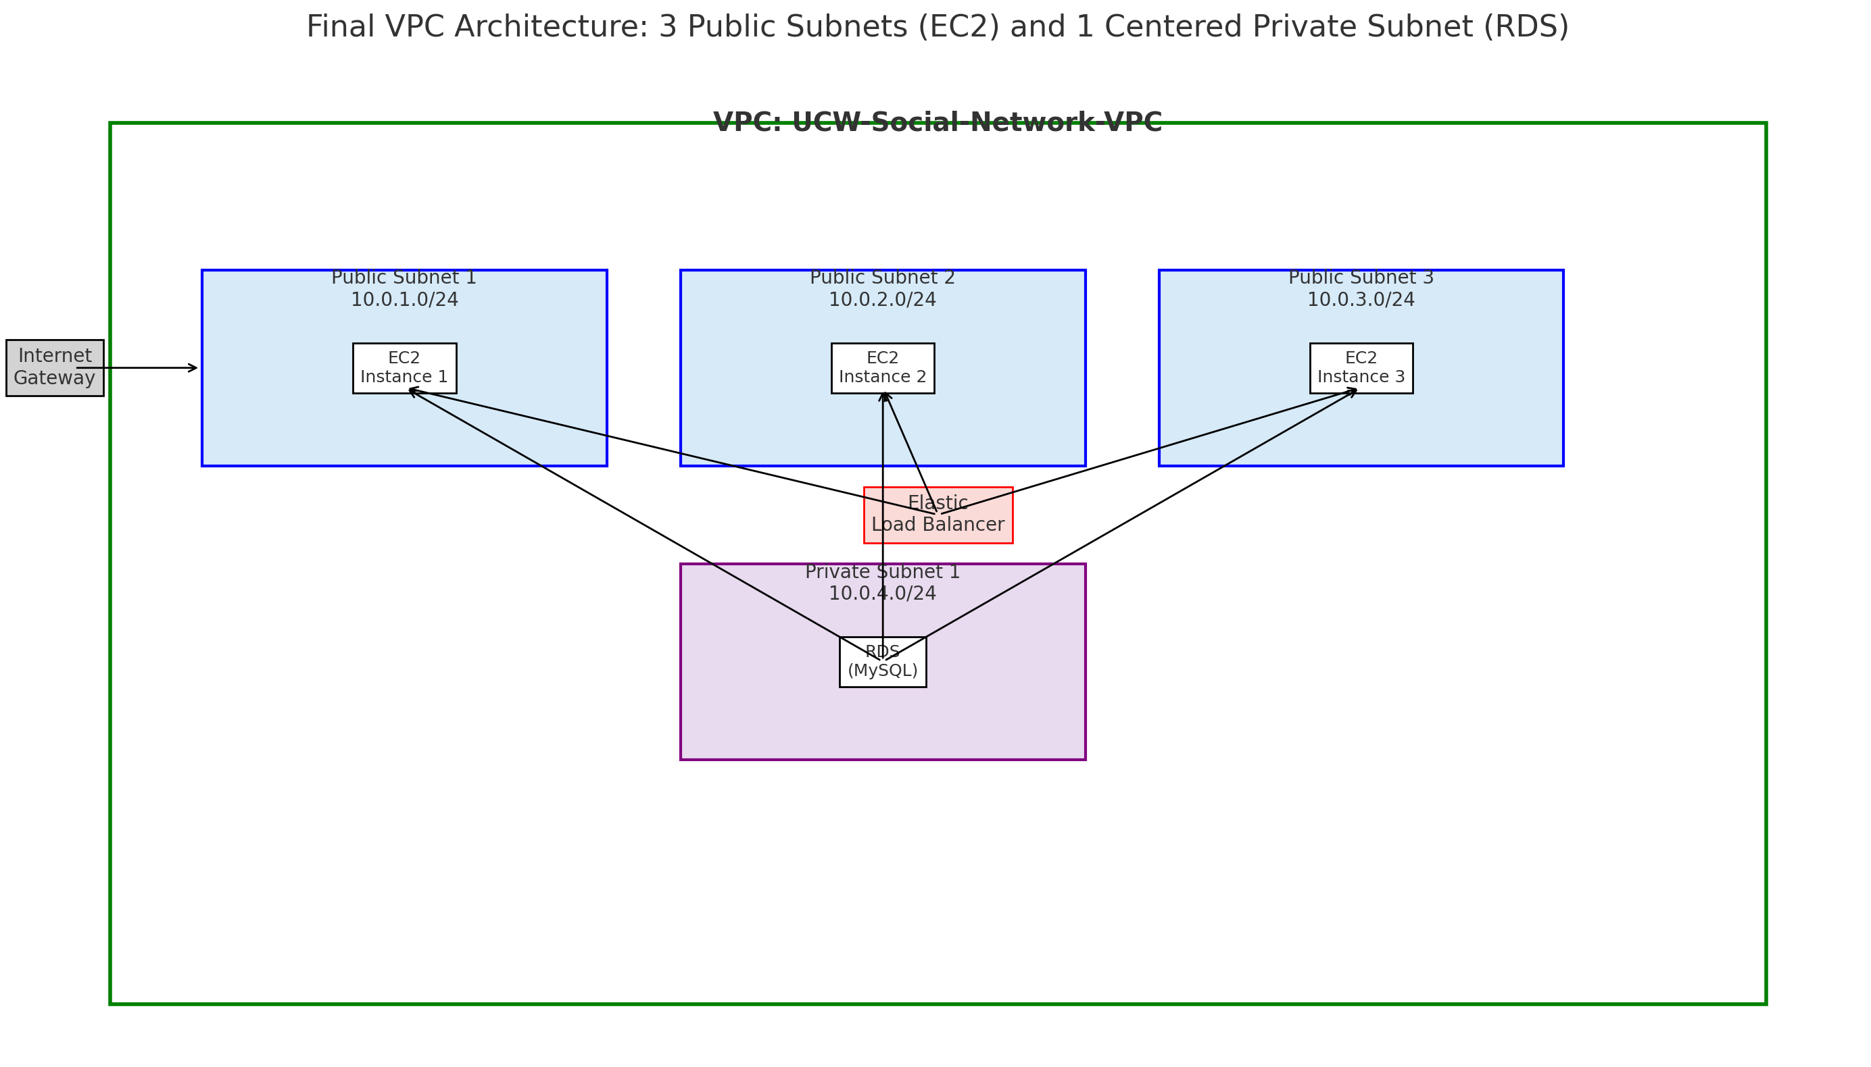
VPC Architecture

Slide 13

Implementation Highlights & Add-ons
Security Configuration:
EC2 Security Group:
SSH (22) — My IP
HTTP (80) — Anywhere
MySQL (3306) — Only from EC2 SG
Elastic Beanstalk Integration:
Set up application environment with PHP 8.x
Adjusted S3 permissions and IAM roles manually
Bonus Work:
Designed a Lambda function to automate RDS snapshot backups to S3 (not executed due to restricted IAM permissions)
Tools Used:
AWS Console, EventBridge (for scheduling), CloudWatch, IAM

Slide 14
Advanced AWS Load Balancer Integration
ELB Setup Process:
Created ELB in AWS Console via EC2 Dashboard.
Configured target groups and health checks.
Adjusted security groups and IAM roles.
Validated setup using the ELB DNS.
Impact:
Fault Tolerance: Redirects traffic from unhealthy to healthy instances.
Scalability: Auto Scaling integration adjusts capacity on demand.
Security: Supports TLS termination, integrates with AWS Shield.

Slide 15

Autoscaling for Social Media Platforms
Autoscaling is crucial for social media platforms to adjust resource utilization and performance based on varying traffic loads. It ensures the platform maintains performance while optimizing costs during different load conditions. AWS autoscaling optimizes performance by automatically managing the number of demanding instances, addressing resource over-provisioning and enabling optimal operation regardless of traffic pattern changes.

Slide 16
Creating an Auto Scaling Group
Launch Template
The process starts with creating a launch template to configure the AMI and instance type. This includes establishing security groups for controlling traffic load and an automated startup script to provision new instances automatically.
Autoscaling Group (ASG)
The launch template sets the stage for creating the ASG with specified minimal and maximal instance numbers. Instances are placed in multiple Availability Zones (AZs) to increase reliability and fault tolerance.
Elastic Load Balancer (ELB)
The autoscaling group is connected to an Elastic Load Balancer (ELB) to optimize load balancing in varied conditions by evenly distributing traffic.

Slide 17
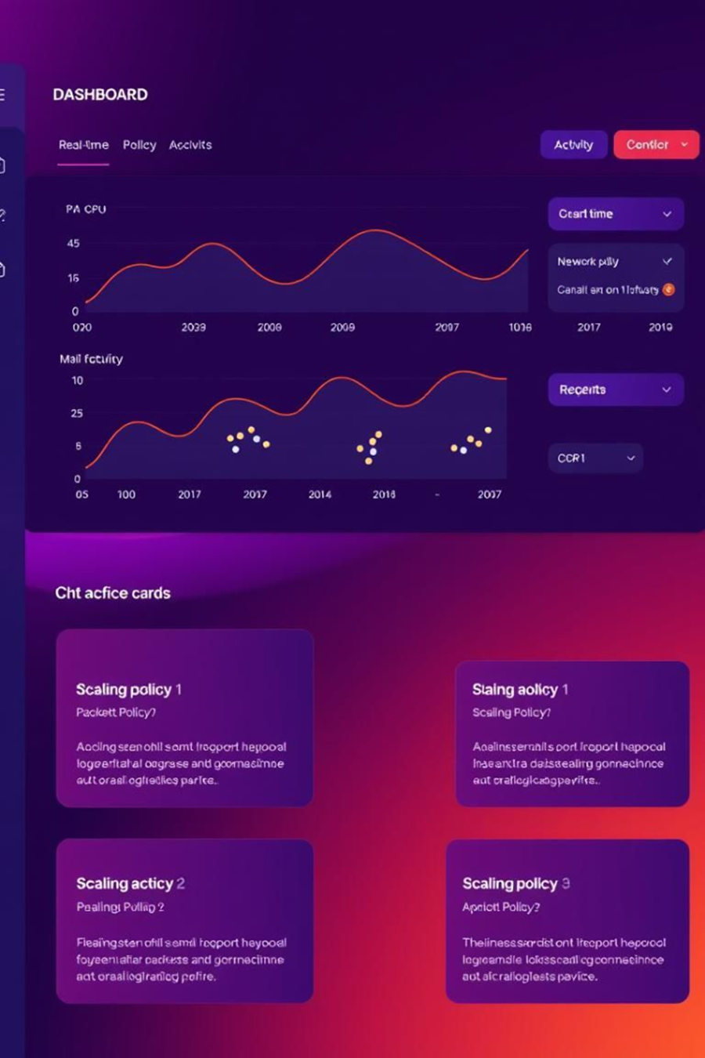

Setting Up Scaling Policies
Real-Time Metrics
Set real-time metrics to determine the number of instances provisioned and de-provisioned. For example, launch an additional instance if CPU utilization exceeds 80% for three minutes
Cost Optimization
Terminate excess instances when CPU utilization drops below 20% for five minutes to optimize costs.
Scheduled Scaling
Define scaling actions based on monitoring usage trends, such as increasing instances during peak hours and decreasing them during low activity periods.

Slide 18
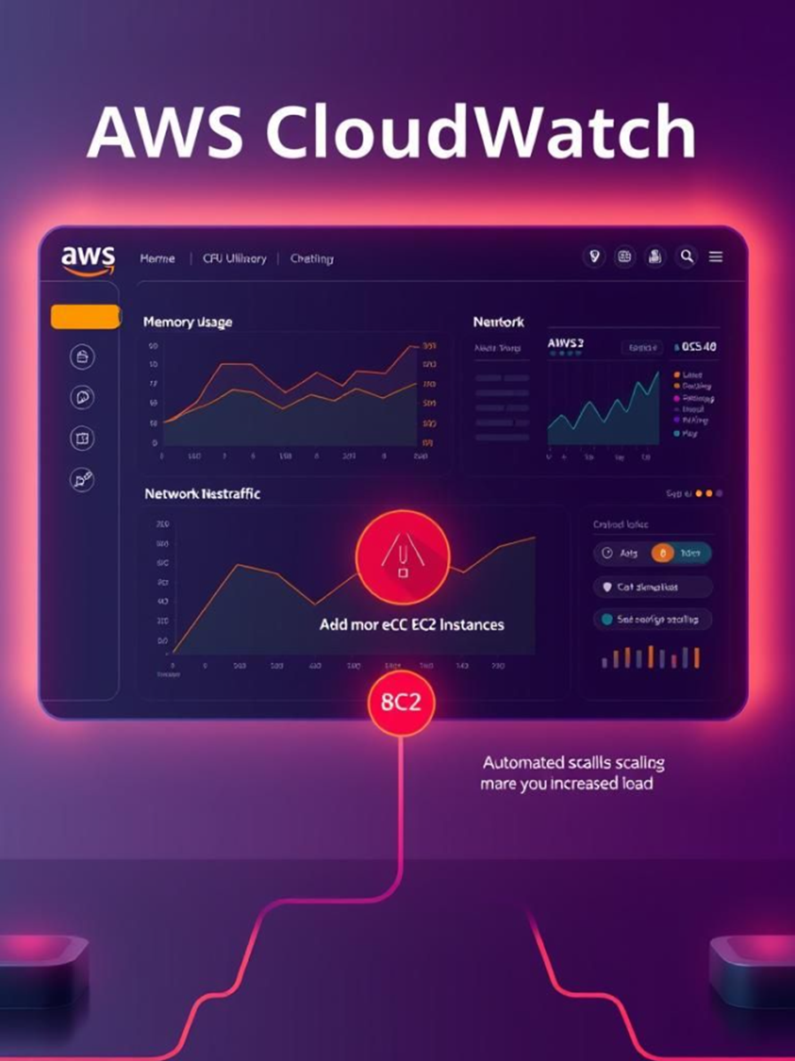
Monitoring and Optimization
AWS CloudWatch
Utilize AWS CloudWatch for monitoring critical indicators like CPU usage, network activity, and response times.
Automated Scaling
Use alarms to automate scaling actions and react to changes in demand in a timely manner.
Cost Management
Combined on demand and reserverd instances for flexibility while controlling costs. Use spot Instances for non-critical workloads to further cut costs.

Slide 19
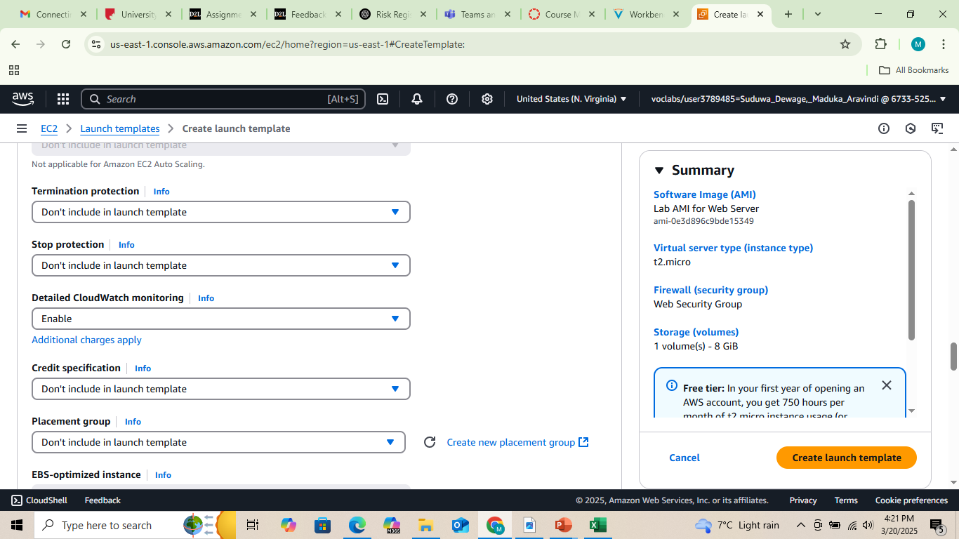
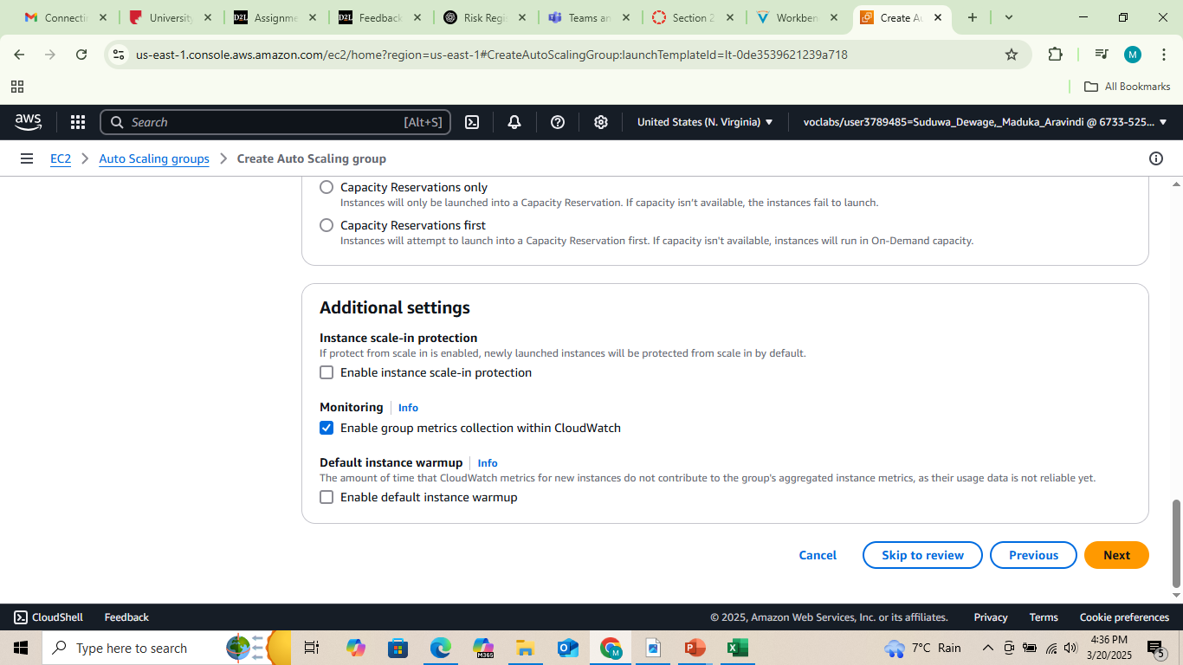
Monitoring with Amazon CloudWatch Implementation
Configuring CloudWatch Monitoring
Launch Template Integration
Monitors EC2 instances every minute
Tracks CPU utilization, network traffic, and system health
Auto Scaling Group Integration
Adjusts EC2 instances dynamically based on workload
Captures metrics at 1-minute intervals

Slide 20
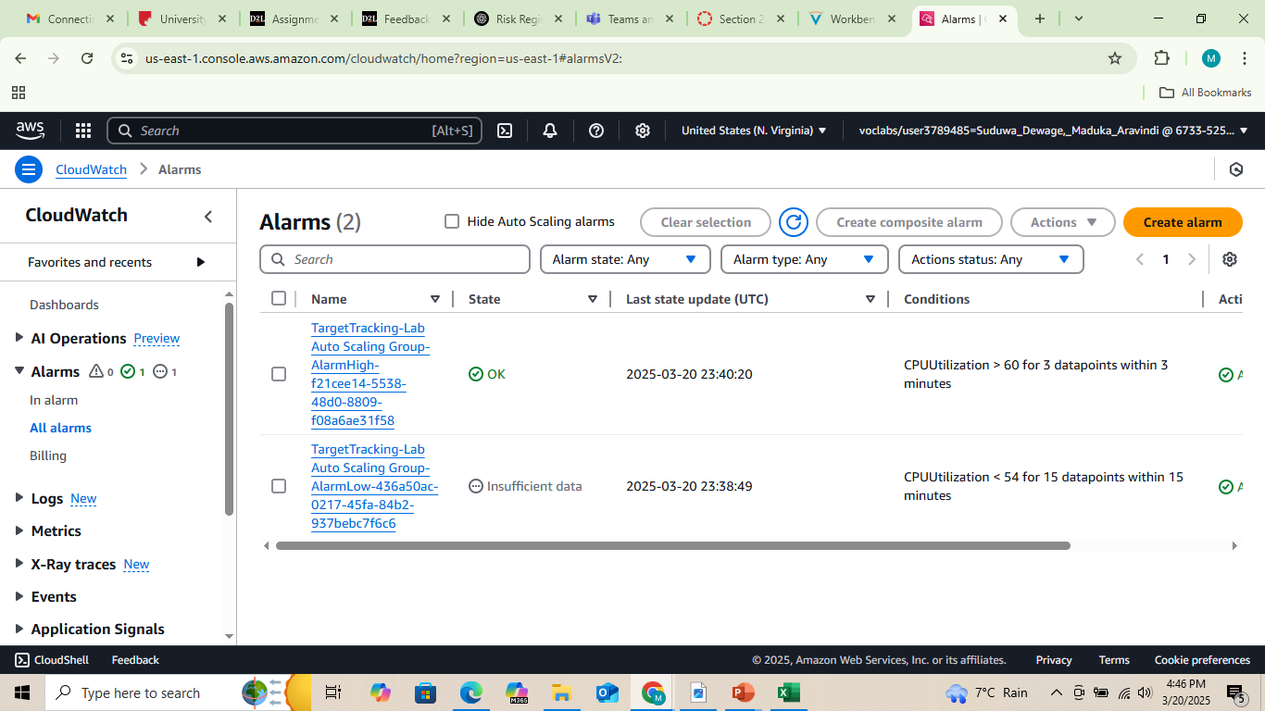
CPU Utilization Monitoring
CloudWatch triggers auto-scaling based on CPU load
Scaling Policies:
Above 60% utilization → Adds instances
Below 54% utilization for 15 min → Removes instances
Goal: Maintain system stability & avoid downtime

Slide 21
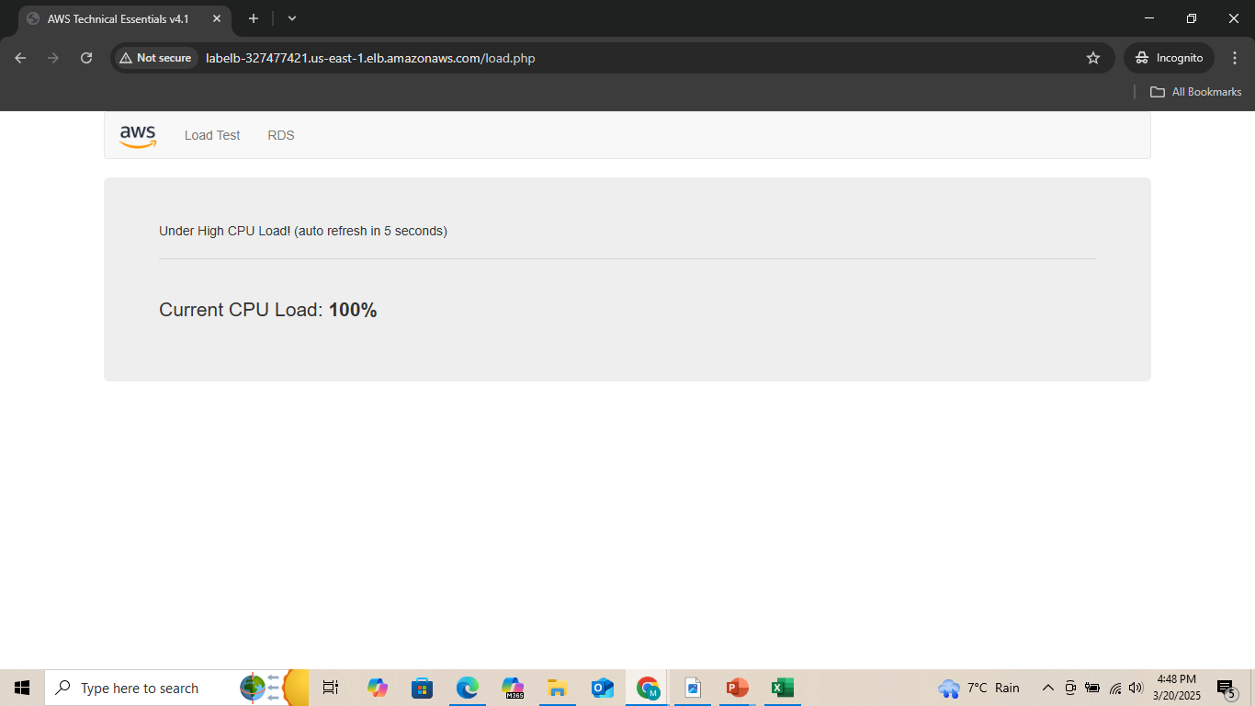
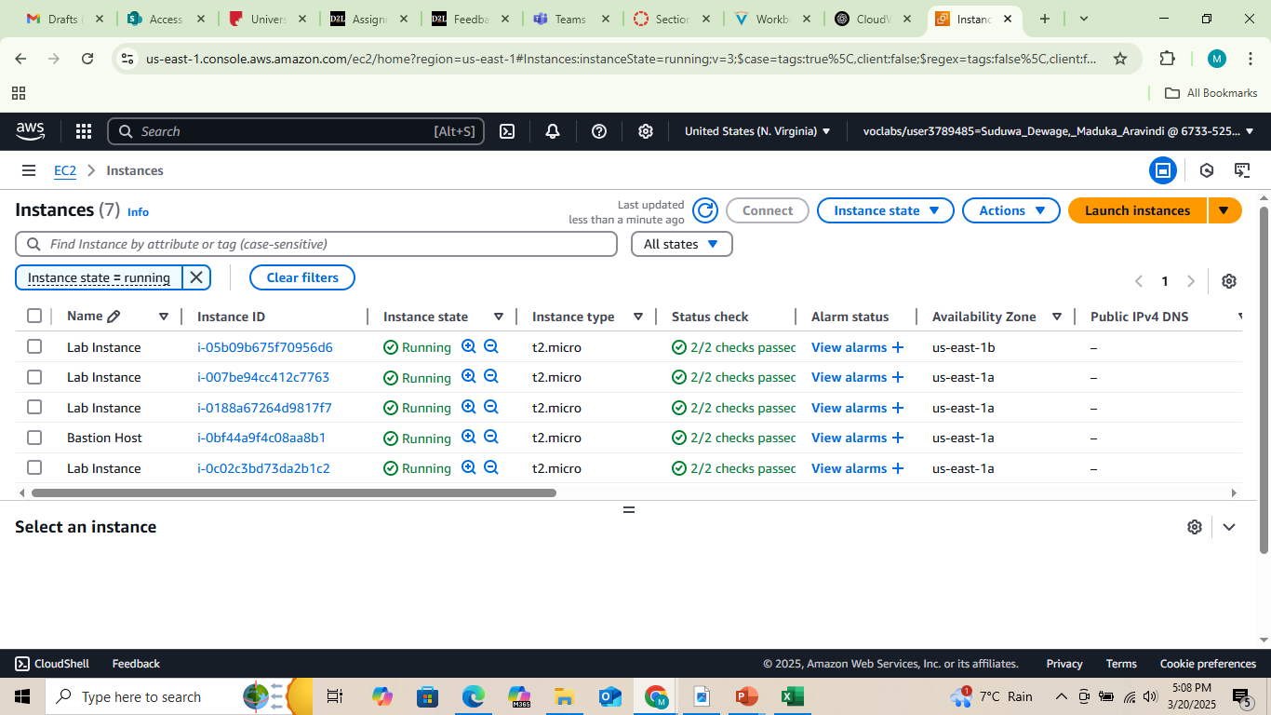
CloudWatch Alarms & Actions
Alarms detect high CPU usage & trigger scaling
Impact of exceeding 60% CPU utilization:
New EC2 instances added automatically
Prevents system overload & lag
Reduces cost by terminating unused instances

Slide 22
AWS IAM Implementation
Objective: To provide specific and secure access control to AWS resources
What happened Unable to create IAM Users, Groups, Roles.We were unable to enable MFA or assign policies.
Reasons: Access Denied errors , IAM role lacked required administrative permissions
Learnings: IAM is powerful but highly permission-controlled, Recommend requesting elevated access before implementation, CloudTrail remains valuable even with limited IAM rights

Slide 23
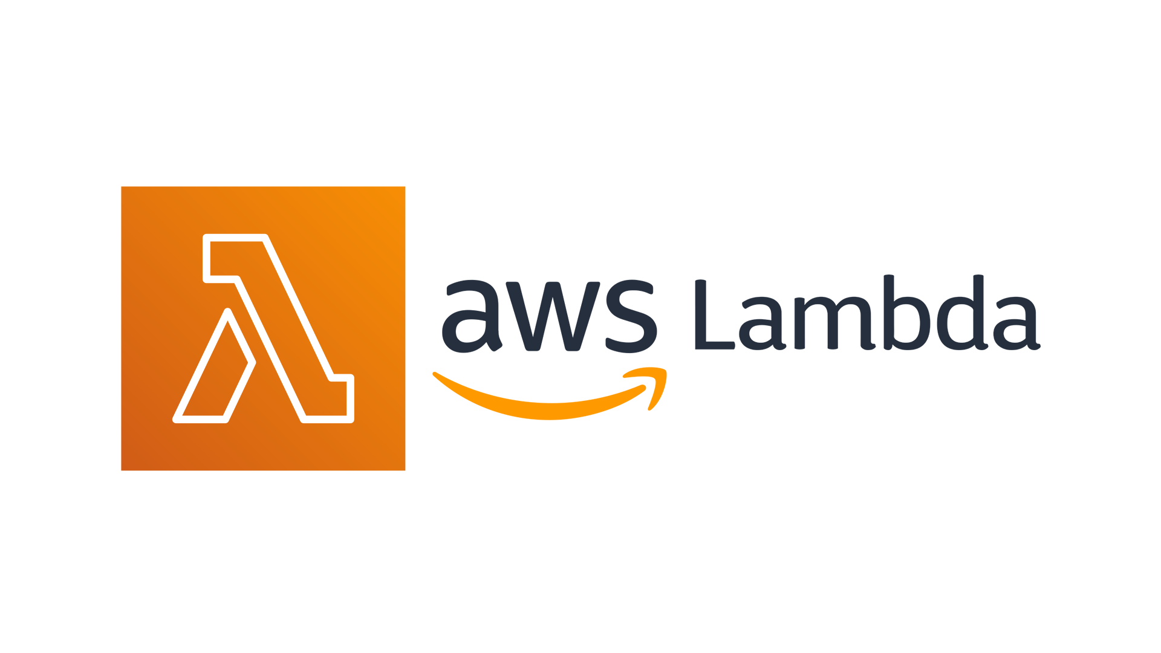
AWS Lambda
Purpose: Serverless computing for event-driven tasks
Use Case:
Sends notifications on university updates
Enables real-time interactions (chats, forums, live Q&A)
Cost Optimization: Runs only when needed

Slide 24
Challenges, Learnings & Reflections
Challenges Faced:
IAM Role Restrictions: Blocked Lambda & Beanstalk execution due to admin rights.
S3 Bucket Access: Required manual policy edits for deployment to succeed.
Security Group Misconfigs: Initially blocked EC2-RDS communication.
Elastic Beanstalk Timeouts: Triggered due to load balancer and role issues.
Time & Skill Constraints: Frontend implementation was out of scope.
Key Learnings:
Deepened understanding of service integrations and IAM policies.
Hands-on experience with EC2-RDS connectivity and Elastic Beanstalk deployments.
Gained awareness of real-world infrastructure and cloud automation practices.

Slide 25

Thank You !!

